Slide 1
CA1 AIML prEDICTING WATER QUALITY
By: ADAM DAAA/07 p2317425

Slide 2
table of contents
Background Research & Data Exploration
Modelling and Evaluation (classification models)
Model Improvement
Data cleaning and imputation

Slide 3
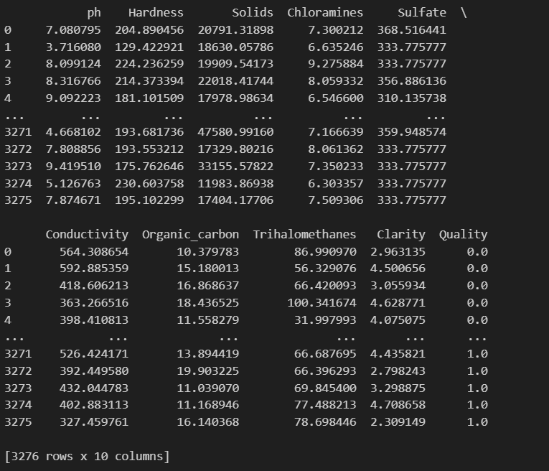
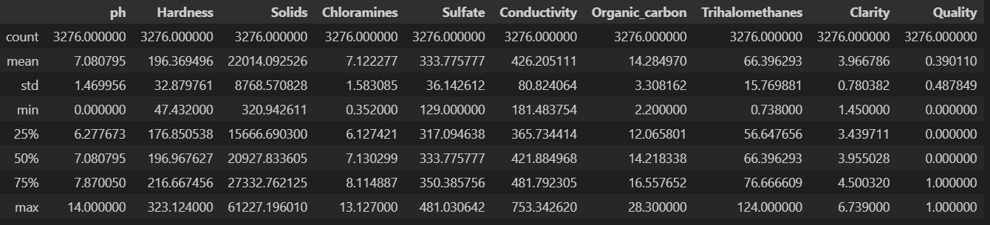
Background Research & Data Exploration
The objective of this assignment is to build a machine learning model to predict water quality based on the water properties.
Overview of the dataset
Information about different properties in water
summary of the central tendency, dispersion, and distribution of values for each variable in your dataset. For instance, you can see the range of values, the average, and how spread out the values are from the mean.

Slide 4
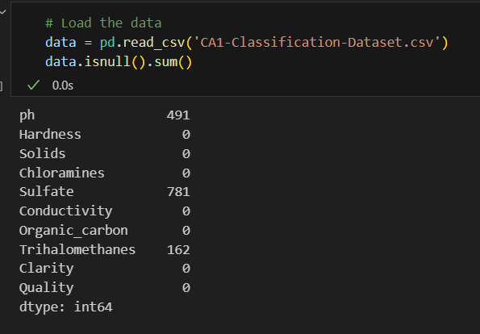
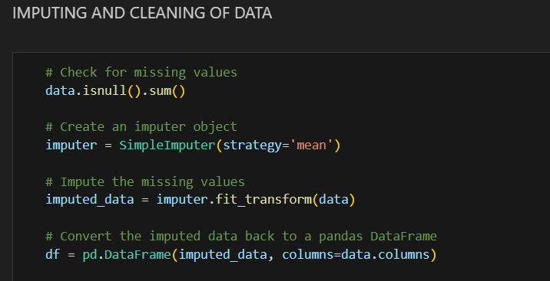
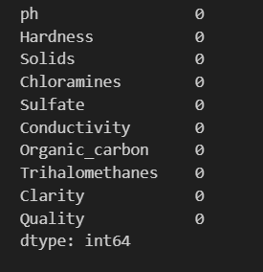
Data cleaning and imputation (feature engineering)
mean strategy. This means that the missing values will be replaced with the mean of the corresponding column.
The numbers show the amount of missing values next to the different water properties
Steps to impute data to fill up the missing values by using an imputer object and the missing values will be replaced with the mean of the corresponding columns.
This would be the final result with no more missing values.

Slide 5
Classification models

Slide 6
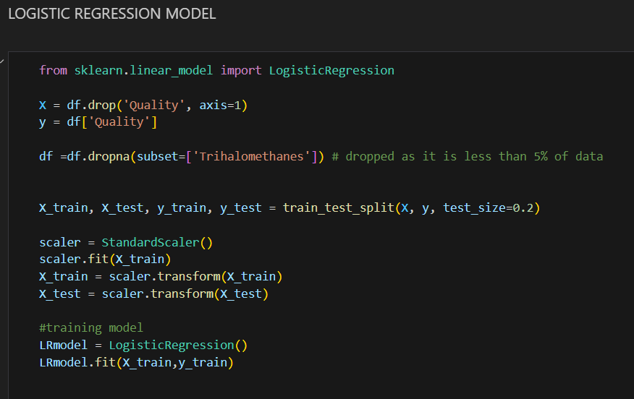
#1 Logistic regression model
My first model is a classification model that was created using logistic regression, the next few slides would be showing my code on how I built the model.
I also had to drop Quality because it is what im predicting and also drop Trihalomethanes since it is less than 5% of the data.
I first load the data and split it into training and testing. Then, I scale the training data using a standard scaler. This is important because logistic regression is sensitive to the size of the data.
Then, the code models a logistic regression object and uses the fit() method to fit it to the training data. Once the model is trained, it can be used to predict the probability of a binary outcome for additional data points using the predict() method.

Slide 7
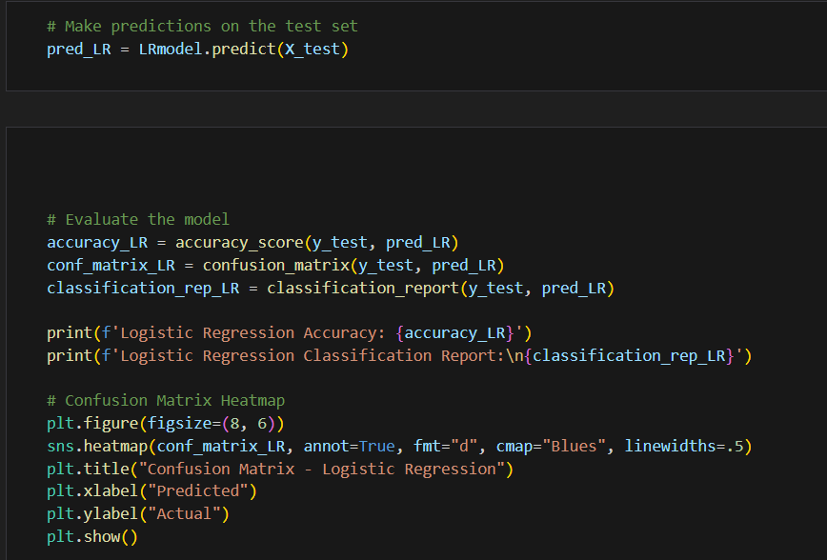
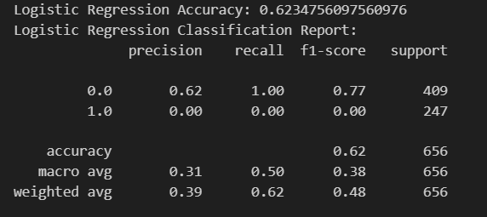
Accuracy: The percentage of predictions that were correct.
Precision: The percentage of positive predictions that were actually correct.
Recall: The percentage of predicted actual positive results.
Weighted Avg: This equates to the weighted accuracy and recall scores, with weights depending on the number of samples in each category.
The Logistic Regression Accuracy of the estimator was 0.6235, indicating that the model correctly predicted 62.35% of the sample. Precision of the 0 class (negative class) was 0.62, indicating that 62% of the negative predictions were actually correct. Recall for the first grade (best grade) was 1.00, indicating that the model predicted all optimal models well. The Weighted Avg Precision is 0.39, and the Weighted Avg Recall is 0.62.
The code was used to make predictions in the experimental design using a logistic regression model.
The model was previously trained on the training set and is now used to predict new data.
The code then analyzes the model on the test set and plots the heat map of the confusion matrix.

Slide 8
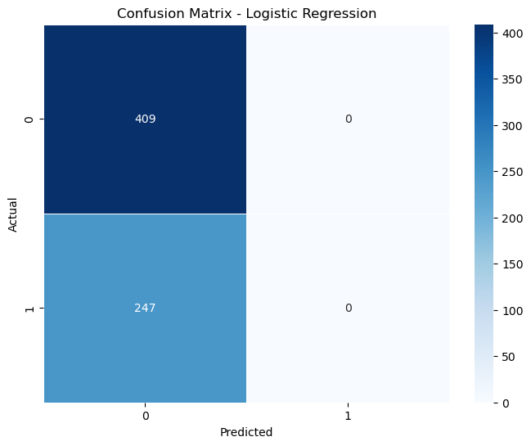
The confusion matrix of the logistic regression classifier in the figure shows that the model correctly predicted 400 samples from class 0 and 247 samples from class 1. The model correctly predicted 0 samples from class 0 as a class 1, and 409 samples from class 1 class 0 .
Overall, the confusion matrix shows a good performance of the logistic regression classifier, with an accuracy of 64.7%. However, the model is likely to incorrectly predict class I samples as class 0 rather than vice versa. This is because there are more samples from class 1 than class 0 in the data set.

Slide 9
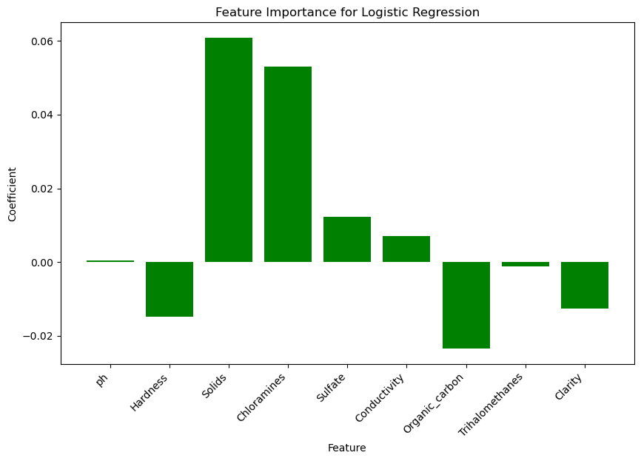
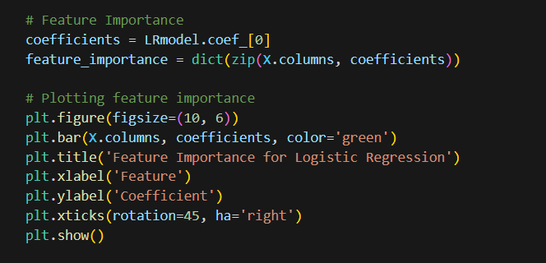
The code first calculates the coefficients of the logistic regression model using the coef_ attribute. Then, it creates a dictionary by assigning feature names to coefficients.
Finally, the code is a bar chart of importance, with factors on the x-axis and coefficients on the y-axis. The trees turn green to indicate that this is a positive outcome.
Feature importance is a measure of how important each feature is for the prediction of a machine learning model. It can be used to identify features that are important for a particular task, and eliminate unnecessary features to improve model performance.
The figure shows the feature importance graph of the logistic regression model. The graph shows that the most important parameters for the model are pH , Hardness, and Solids. The least important are Organic_carbon, Trihalomethanes, and Clarity.
This indicates that the model is very sensitive to water pH, hardness, and solids content when predicting the probability of two outcomes This is possible because these parameters are good indicators that there are chemicals or contaminants in water.
The graph also shows that all feature importance values ​​are positive. This indicates that all factors contribute positively to the predictions in the model.

Slide 10
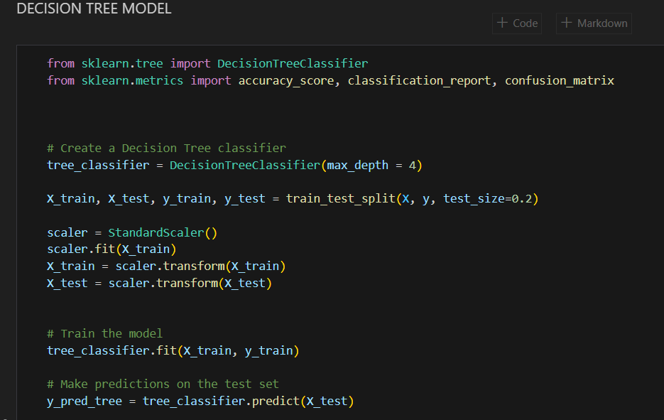
#2 decision tree model
My second classification model would be a decision tree model. the next few slides would be showing my code on how I built the model.
The code first creates a DecisionTreeClassifier object, which specifies a maximum depth of 4. Maximum depth is a hyperparameter that controls the complexity of the decision tree A larger depth will produce a more complex tree, which can be more accurate but also smoother that it would fit too well.
Next, the code splits the training data into trains and test sets using the train_test_split() function. The test set will be used to evaluate the performance of the trained model.
The code snippet then uses the StandardScaler() class to standardize the training data. Standardization is a common preprocessing step for machine learning models, as it helps ensure that all elements are on the same scale.
Finally, the code trains a decision tree classifier on the training data using the fit() method. Once the model is trained, it can be used to predict test data using the predict() method.

Slide 11
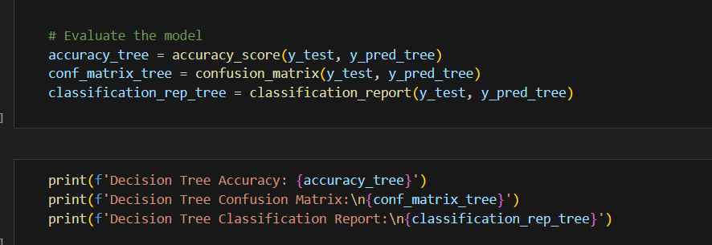
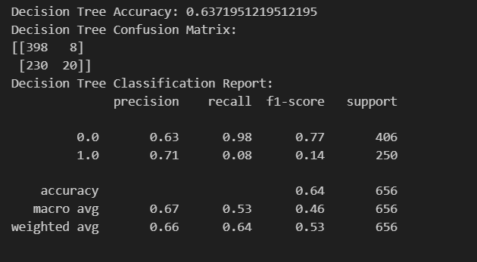
The code evaluates the performance of the decision tree classification model on the test set. The code first estimates the model accuracy, which is the portion of the test model that the model predicts well. The code then calculates the confusion matrix, which is a table showing how many test samples from each class were predicted as per class. Finally, the code computes a classification report, which provides a detailed summary of the model’s performance, including precision, recall, and F1 scores for each class
The results show that the decision tree has an accuracy of 63.72% on the test set. The confusion matrix shows that the decision tree correctly predicted 398 out of 406 positive cases and 20 out of 250 negative cases. The reported classification shows that the accuracy of the decision tree is 71% for positive cases and 63% for negative cases. 64% of cases and 8% of controls are recalled. The F1 score was 77% in positive cases and 14% in negative cases.

Slide 12
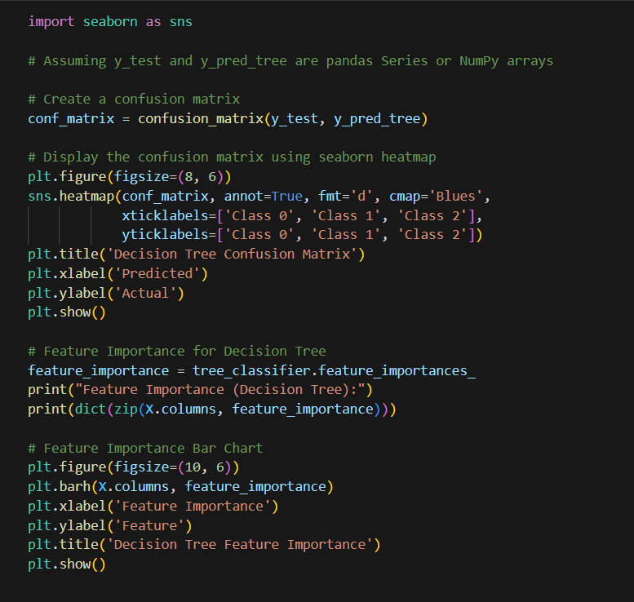
The code is basically a confusion matrix that uses a heat map of ocean generation to predict predictions vs. predictions. the actual outcome
The code shows how to create a feature importance bar chart for decision tree classification. The code uses the feature_importances_ attribute of the decision tree classification to derive the feature importance values. The code then writes the feature need values ​​as a bar chart using the plt.barh() function.

Slide 13
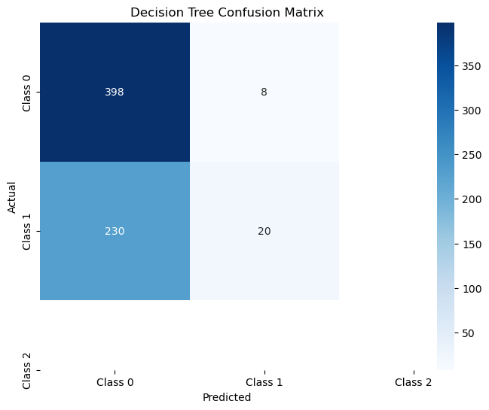
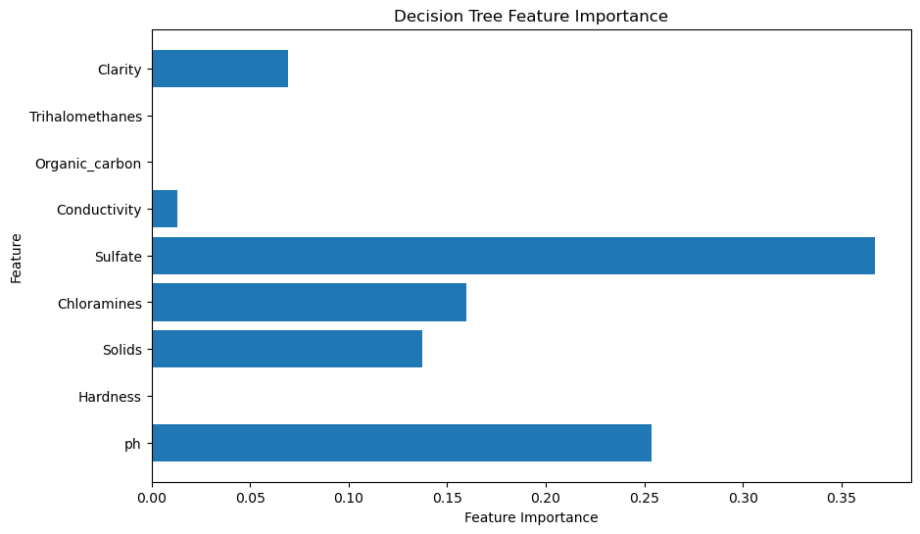
Output :
The figure shows that decision tree classification performed well in Class 0 and Class 1, with higher TP values ​​and lower FP and FN values. However, the classifier performed poorly in Class 2, where TP values ​​were low and FP and FN values ​​were high.
This means that the decision tree classifier is able to find features that distinguish class 0 from class I, but it has difficulty finding features that distinguish class II from the other two classes
The graph shows that the most important factor is clarity, followed by trihalomethane, organic_carbon, conductivity, sulfate, chloramine, solids, hardness, and pH
This means that the decision tree uses these features to make predictions about the target variable. Since the target variable is water quality, the decision tree will use these parameters to determine whether the water is safe to drink.
The figure also shows the importance of different factors. For example, clarity is much more important than pH. This suggests that clarity is a more reliable indicator of the target variable than pH.
Overall, the graph provides a valuable overview of the importance of different factors in the decision tree. This information can be used to understand how the decision tree predicts and improve the accuracy of the model.

Slide 14
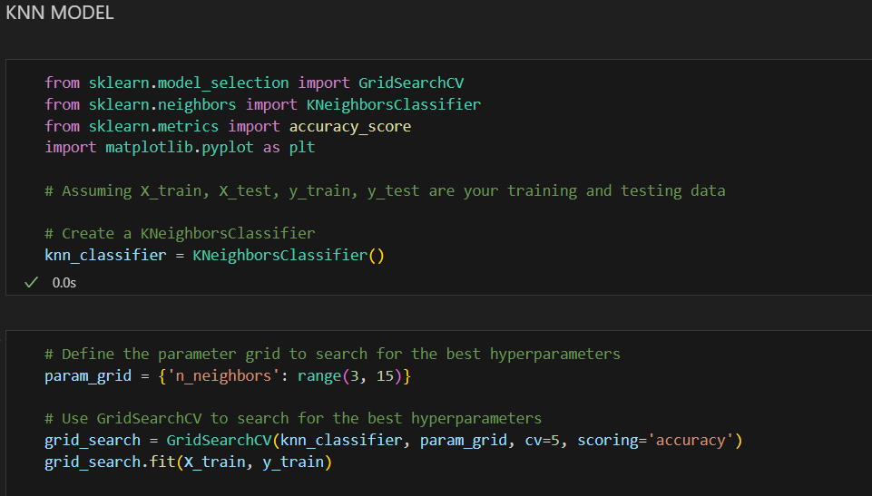
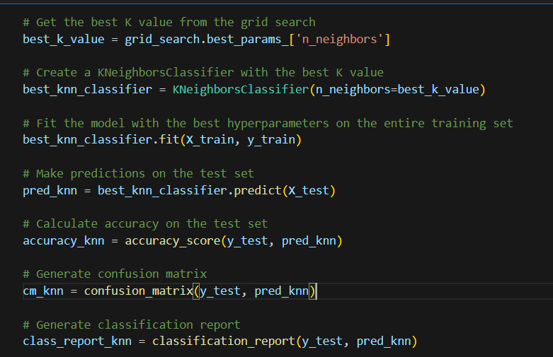
#3 KNN model
My second classification model would be a KNN model. the next few slides would be showing my code on how I built the model.
The code first creates a GridSearchCV object to find the best value of the n_neighbors hyperparameter. The n_neighbors hyperparameter controls the number of neighbors used for prediction.
Once the GridSearchCV object is created, the code matches it to the training data. This will train the KNN classifier and find the optimal value of the n_neighbors hyperparameter.
Finally, the code prints the KNN classification accuracy score on the test data. It is a measure of how well a KNN classifier can generalize to unseen data.
Obtain the best value of the n_neighbors hyperparameter from a web search.
Line 3: Construct the KNN classifier with the optimal value of the n_neighbors hyperparameter.
Line 4: Fit the KNN classifier to the training data.
Step 5: Make predictions about the test data.
Line 6: Calculate the accuracy of the KNN classifier on the test data.
Line 7: Construct the confusion matrix for the KNN classifier.
Line 8: Generate the classification report of the KNN classification report.

Slide 15
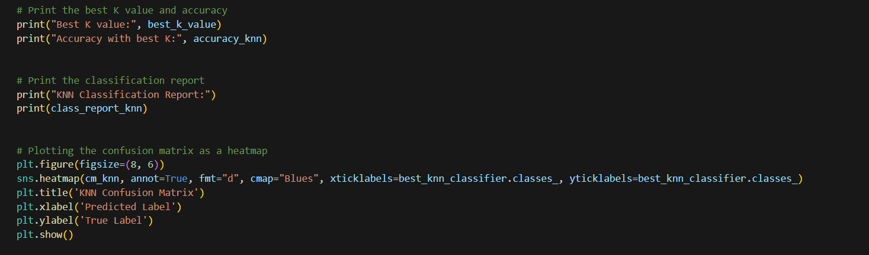
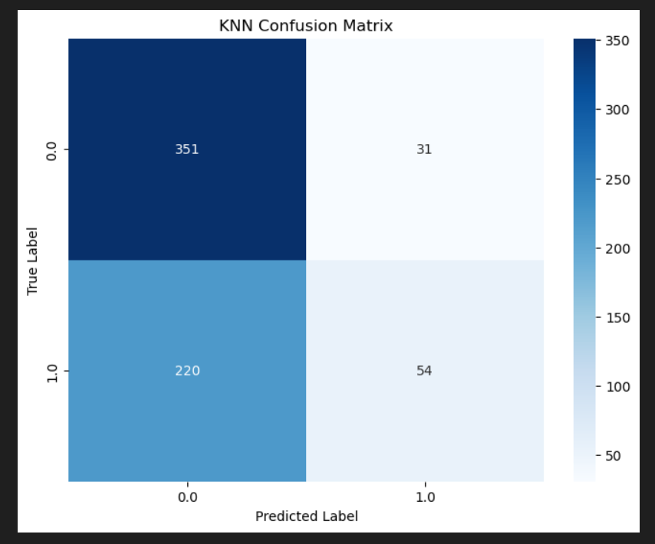
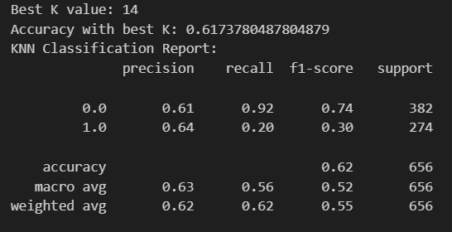
The overall accuracy of the classification is 63.0%, indicating that it predicts well the class of the new data point 63% of the time. The gross average accuracy, recall, and f1-scores were all 62.0%, indicating that the classifier performed equally well in both disciplines. The weighted average precision, recall, and f1 scores were 55 .
The rows of the matrix represent the actual columns and columns in the data and the predicted columns. The number in each cell represents the number of data points assigned to that particular combination of actual and predicted scores.
The diagonal of the figure indicates the number of data points that were correctly classified. In this case, 351 data points were correctly classified as label 0.0, and 220 data points were correctly classified as label 1.0.

Slide 16
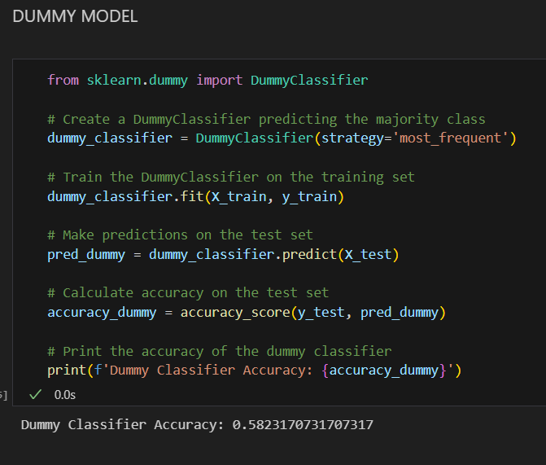
#4 dummy model
The code is a new dummy classifier object with strategy most_frequent, which means that the classifier will identify the most frequent classes in the training data for all new data points after which the dummy classifier will be trained on the training set. Finally, it computes the accuracy of the dummy distribution by making predictions on the test set.

Slide 17
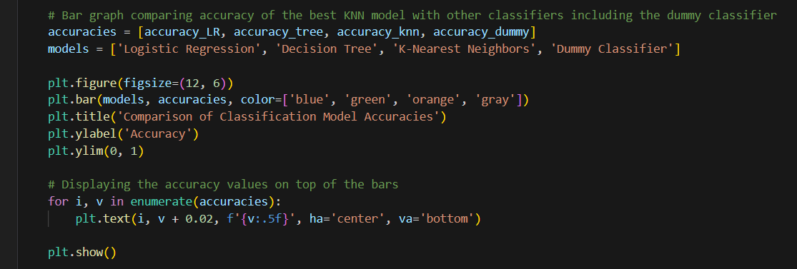
This refers to a comparison of classification model accuracy, where the best KNN model is compared with other classifiers including dummy classifiers.

Slide 18
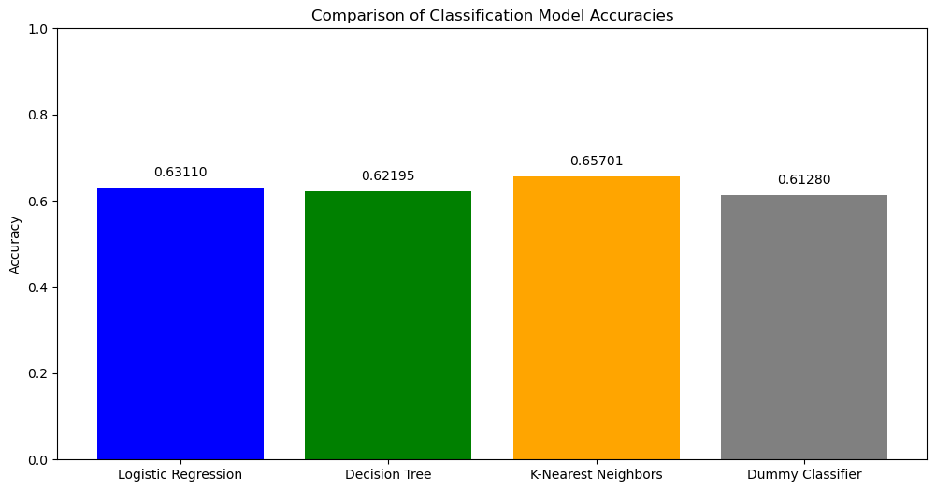
ACCURACIES OF DIFFERENT MODELS
After multiple times of running the models, we can conclude that KNN model is the most accurate one as it is consistently the most accurate one, followed By Logistic Regression model and Decision Tree model. The three model constantly outperform the dummy model , highlights their ability to learn from the data and make more accurate predictions, underscoring their value in various machine learning applications.

Slide 19
Final model
KNN MODEL WITH AN ACCURACY OF 0.65701

